Slide 1

SASI VS RYGB:NUOVA TECNICA VS GOLD STANDART
RELATORE: Dott. Moioli davide
AffiliaZIONE: Policlinico San Marco Zingonia

Slide 2



INTRODUZIONE
Il 20-30% dei pazienti può sperimentare un recupero di peso post sleeve gastrectomy, rendendo necessarie procedure di revisione.
RYGB rappresenta la procedura di reintervento:
Più comunemente utilizzato
Gold standard
Single Anastomosis Sleeve Ileal Bypass (SASI) è recentemente stato proposto come opzione di reintervento per:
Bilanciamento favorevole tra meccanismi restrittivi e malassorbitivi
Semplicità tecnica
RYGB
Notes:
As we know Sleeve gastrectomy has a post operative reflux rate from 10-50 %, even in patient not refluxer before the surgical intervention.
In our experience 25% of patients present a Hiatal hernia to the EGDS or develop it after Sleeve.
Currently the gold standard for gerd onset after sleeve is Roux and Y gastric by-pass
In literature, various therapeutic options have been described, including only Hiatoplasty in case of hiatal hernia.

Slide 3

OBBIETTIVO
Per confrontare SASI e RYGB come procedure di re-intervento dopo SG abbiamo valutato:
Efficacia
Profilo di sicurezza
Implicazioni cliniche
Per guidare la decisione terapeutica personalizzata.

Slide 4

MATERIALI:
Studio retrospettivo che include:
Pazienti di età compresa tra 18 e 65 anni di entrambi i sessi
SASI o RYGB tra il 2023 e il 2024.
Recupero di peso/GERD
Tutti i pazienti sono stati informati della natura ancora sperimentale della tecnica SASI
INCLUSION CRITERIA:
Notes:
We examinated our cohort of 6500 patient who underwent to sleeve gastrectomy in the period two thousand and fiftenn two towsand twenty three.
Inclusion criteria were:

Slide 5

METODI:
I parametri analizzati includevano:
Peso
BMI
%EWL
%TWL
Remissione di:
Diabete di tipo 2
Ipertensione
OSAS
GERD
Complicanze chirurgiche (secondo la classificazione di Clavien-Dindo)
Esiti nutrizionali.
Follow-up sono a 1, 6 e 12 mesi dopo l'intervento. I parametri nutrizionali sono stati analizzati a 12 mesi.

Slide 6
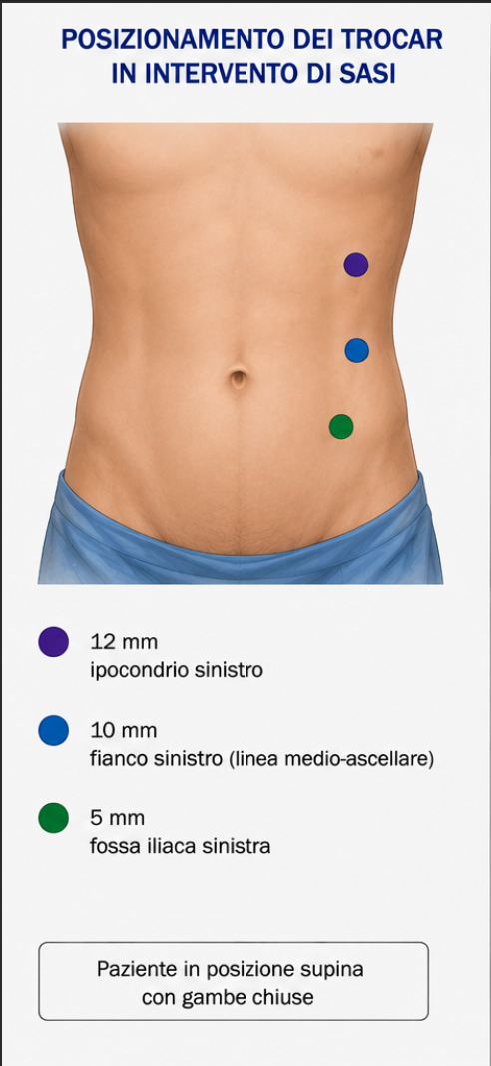
Tecnica chirurgica:

Slide 7
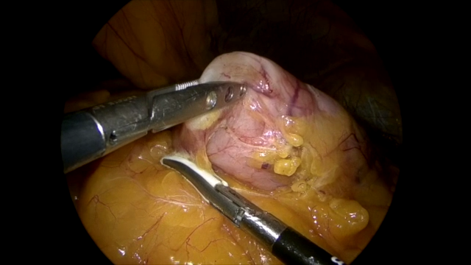
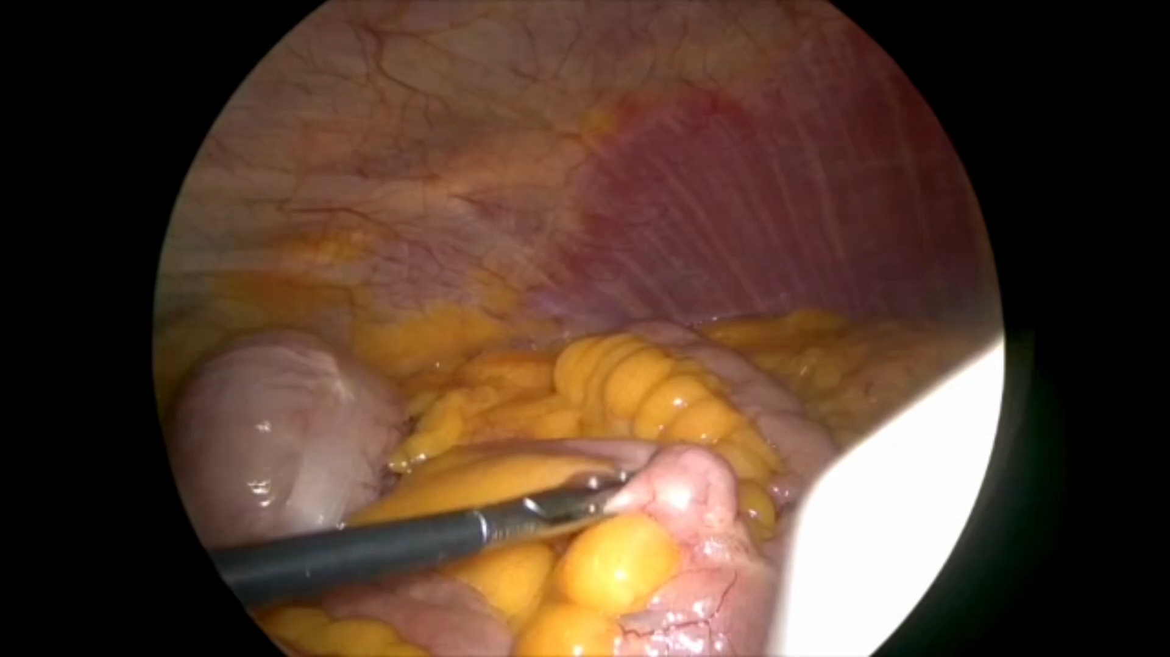
INTERVENTO CHIRURGICO:
Notes:
Surgical intervention was performed in laparoscopy with hiatoplasty created with non absorbable stiches with extracorporeal knot.

Slide 8
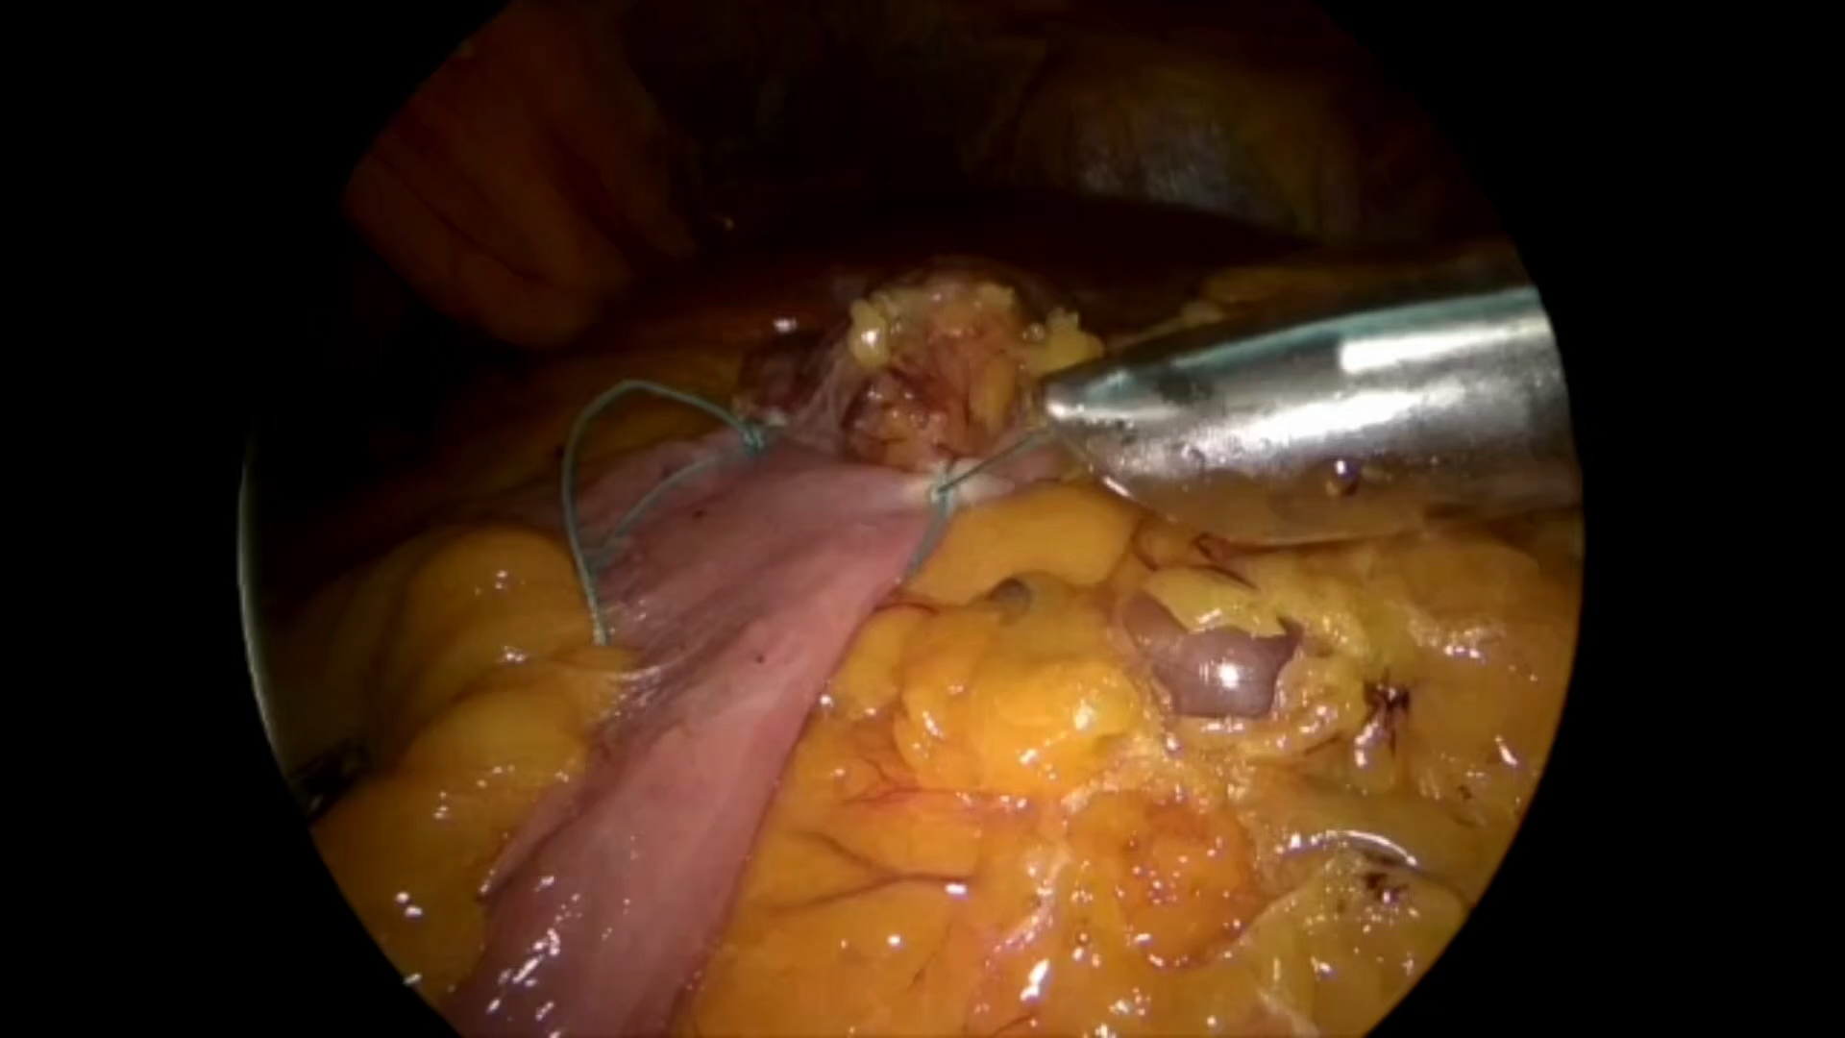
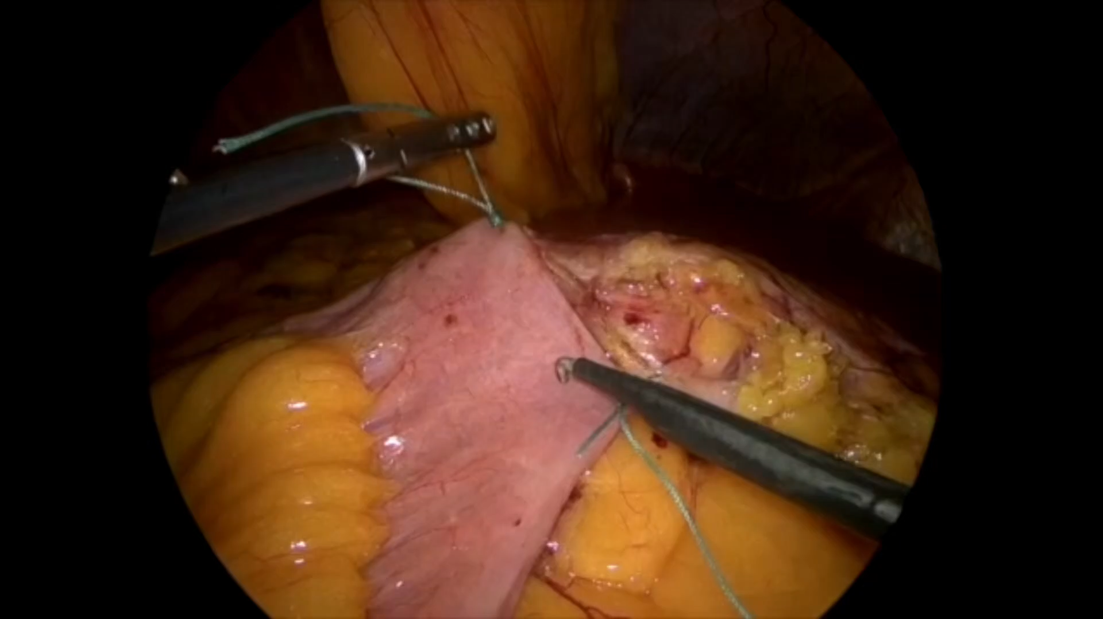
INTERVENTO CHIRURGICO:
Notes:
Surgical intervention was performed in laparoscopy with hiatoplasty created with non absorbable stiches with extracorporeal knot.

Slide 9
RISULTATI:
 | SASI | RYGB
Pazienti | 30 | 28
Età Media | 50±10,75 | 44,3±9,8
P pre intervento(Kg) | 124±29,1 | 113,8 ± 6,8
BMI (Kg/m2) | 45,05±5,4 | 43,2±4,0
Tempo medio | 40,74±11,2 | 73±16,6
Complicanze (30gg) | none | none
Durata degenza (giorni) | 3±1 | 3±2,5
DATI PERI- INTERVENTO
PRE OPERATIVE DATA
Notes:
two hundred patients were included in the study, with a mean age of fourtyone years old.
Mean BMI before sleeve was 43
Mean BMI before hiatoplasty was 25,7
No intra or post operative complications ( according with clavien dindo classification)
Mean lenght of stay was 3 days

Slide 10
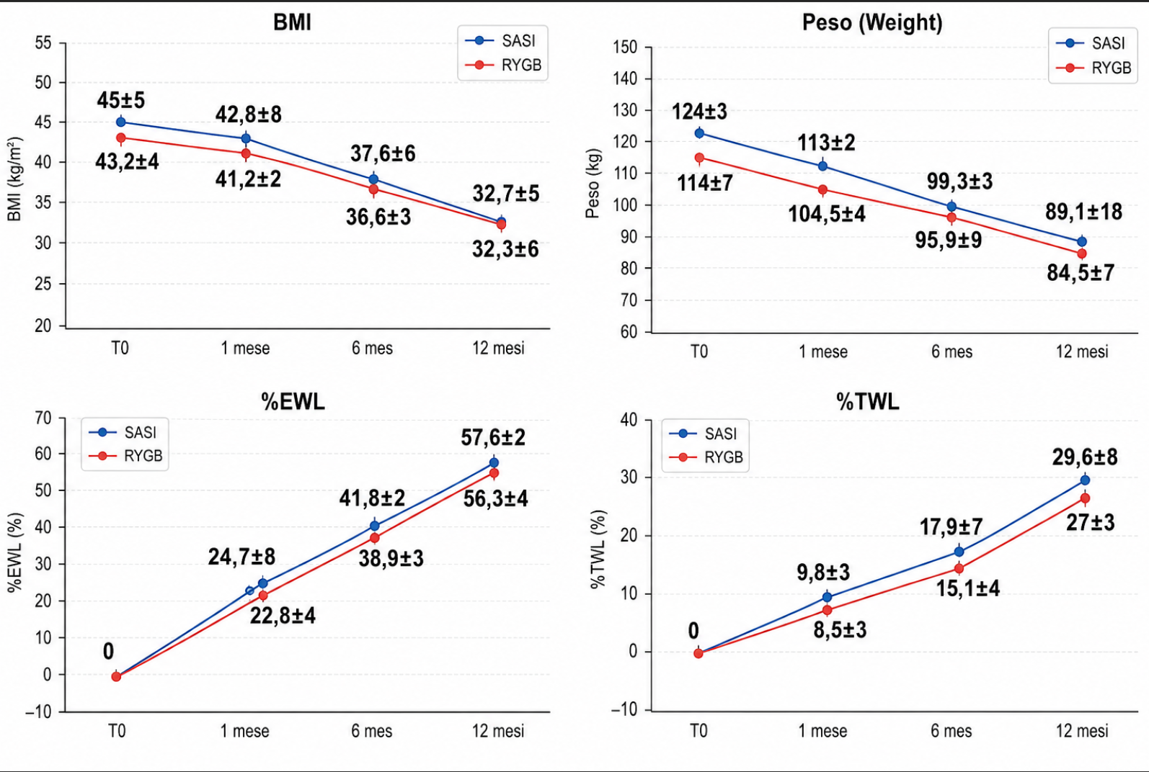
57,6 ± 2
53,6 ± 4
41,8 ± 2
38,9 ± 3
29,6 ± 8
24,7 ± 8
22,8 ± 4
17,9 ± 7
27,0 ± 3
32,7 ± 5
9,8 ± 3
15,1 ± 4
32,3 ± 6
8,5 ± 3
Notes:
two hundred patients were included in the study, with a mean age of fourtyone years old.
Mean BMI before sleeve was 43
Mean BMI before hiatoplasty was 25,7
No intra or post operative complications ( according with clavien dindo classification)
Mean lenght of stay was 3 days

Slide 11
VARIAZIONE COMORBIDITA’ 1-6-12 MESI:
Notes:
two hundred patients were included in the study, with a mean age of fourtyone years old.
Mean BMI before sleeve was 43
Mean BMI before hiatoplasty was 25,7
No intra or post operative complications ( according with clavien dindo classification)
Mean lenght of stay was 3 days

Slide 12

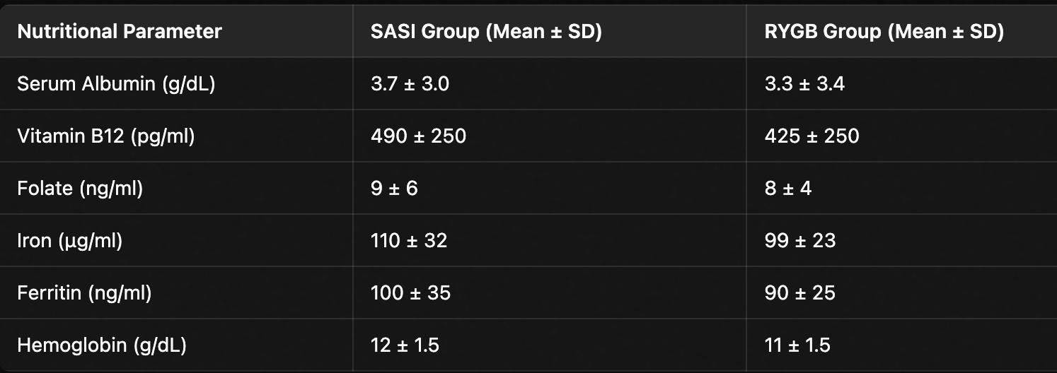
STATO NUTRIZIONALE A 12 MESI
12 month nutritional evaluation
TASSO DI MALNUTRIZIONE BASSO
Notes:
two hundred patients were included in the study, with a mean age of fourtyone years old.
Mean BMI before sleeve was 43
Mean BMI before hiatoplasty was 25,7
No intra or post operative complications ( according with clavien dindo classification)
Mean lenght of stay was 3 days

Slide 13

ANALISI STATISTICA:
I confronti aggiustati per il valore basale hanno mostrato:
​
NESSUNA differenza significativa nel BMI a 12 mesi (variazione IMC: -12,35 vs -10,90, p = 0,35).
​
NESSUNA differenza significativa nella %EWL (p corretta di Holm > 0,005)
​
NESSUNA differenza significativa nella %TWL (p corretta di Holm ≥ 0,167)
​​
Notes:
two hundred patients were included in the study, with a mean age of fourtyone years old.
Mean BMI before sleeve was 43
Mean BMI before hiatoplasty was 25,7
No intra or post operative complications ( according with clavien dindo classification)
Mean lenght of stay was 3 days

Slide 14

Conclusioni:
Mean operative Time (minutes) | 40,74±11,2 | 73±16,6
Surgical complications | none | none
Mean post operative stay (Days) | 3±1 | 3±2,5
Assenza di complicanze peri o post-operatorie
SASI procedura veloce e sicura
Notes:
Processing the de novo Gerd after sleeve mechanism development we can identify two reasons:
- Elevated intraluminal pressure after sleeve
- anatomical damage of LES mechanism during SG

Slide 15
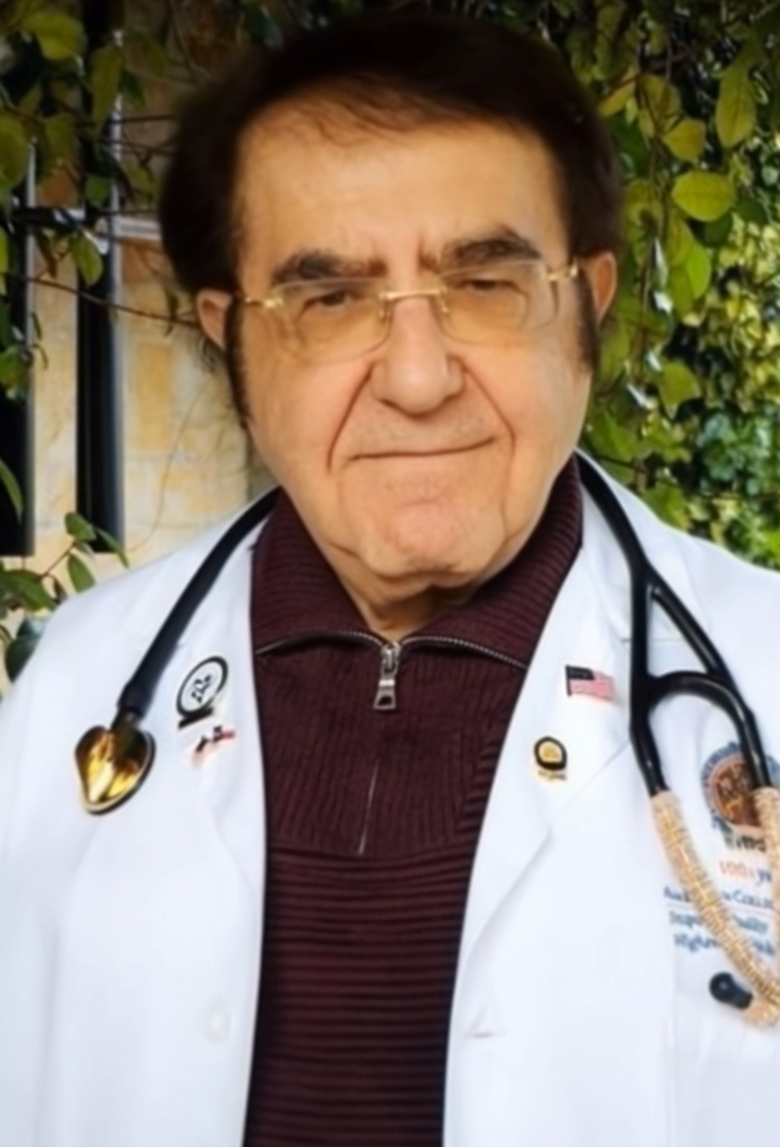
CONCLUSIONI:
Il confronto tra SASI e RYGB dopo la Sleeve Gastrectomy mostra:
Entrambe efficaci nella riduzione di BMI e peso
Significativo miglioramento metabolico e delle comorbidità.
SASI potrebbe rappresentare un'alternativa chirurgica valida al RYGB
Sono necessari studi con un follow-up
più lungo per
Notes:
Processing the de novo Gerd after sleeve mechanism development we can identify two reasons:
- Elevated intraluminal pressure after sleeve
- anatomical damage of LES mechanism during SG

Slide 16
Grazie per l’attenzione

